Slide 1
Text Mining & NLP Dictionary Based Sentiment Analysis
Ted Kwartler

Slide 2
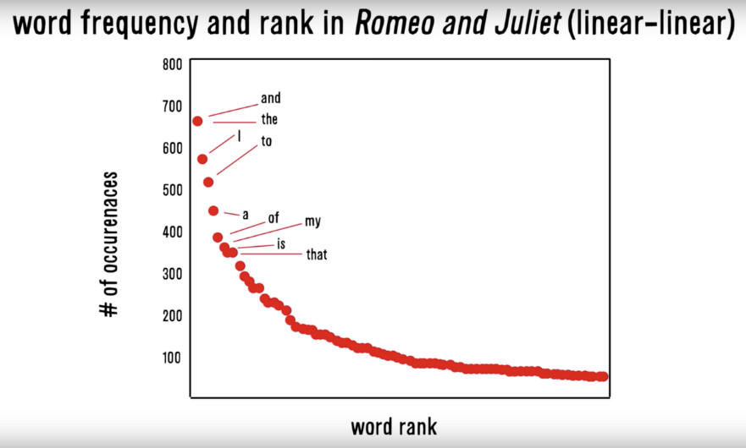
Zipf’s Law: Our words are less diverse than we think
Another Example
Many words in natural language but also a steep decline in actual usage.
Follows a predictable pattern.

Slide 3
Why do we see Zipf’s law in linguistics?
Principle of Least Effort Theory
Humans will choose a path of least resistance
Humans seek to minimize effort for a task
Therefore, even if we know 000s of words, we will use as few as possible to communicate.

Slide 4
Polarity
To what extent is a document positive or negative.

Slide 5
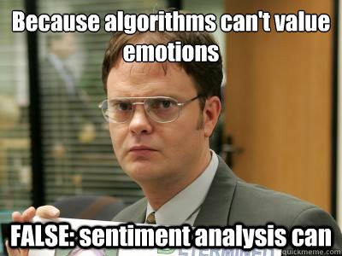
Let’s see if we can do it

Slide 6
How would you rate the polarity?
I loathe Aldi.
loathe
-1

Slide 7
How would you rate the polarity?
I love Carrefour. They are the best.
love
best
+2

Slide 8
How would you rate the polarity?
I like shopping at Migros but hate the location.
like
hate
+2

Slide 9
How did you do that?
-1
I loathe Aldi.
I love Carrefour. They are the best.
I like shopping at Migros but hate the location.
+2
+1
-1
0
You know groups of positive and negative words. These could be called a polarity lexicon

Slide 10
Simple Sentiment Polarity
Zipf’s Law
Many words in natural language but there is steep decline in everyday usage. Follows a predictable pattern.

Slide 11
Simple Sentiment Polarity
Lexicon
Because of Zipf’s Law you can have pos/neg lexicons that do not encompass all possible terms.
library(qdap)
polarity()
library(SentimentAnalysis)
analyzeSentiment()
library(sentimentr)
sentiment()
library(tidytext) & library(dplyr)
inner_join()

Slide 12

Differences between Polarity & Emotion
Polarity isn’t an emotion
Surprise is an emotion
Some emotions can be positive & negative
Surprise! You won the lottery!!

Slide 13
Differences between Polarity & Emotion
Polarity isn’t an emotion
Surprise is an emotion
Some emotions can be positive & negative
Surprise! You were hit by a bus!!

Slide 14
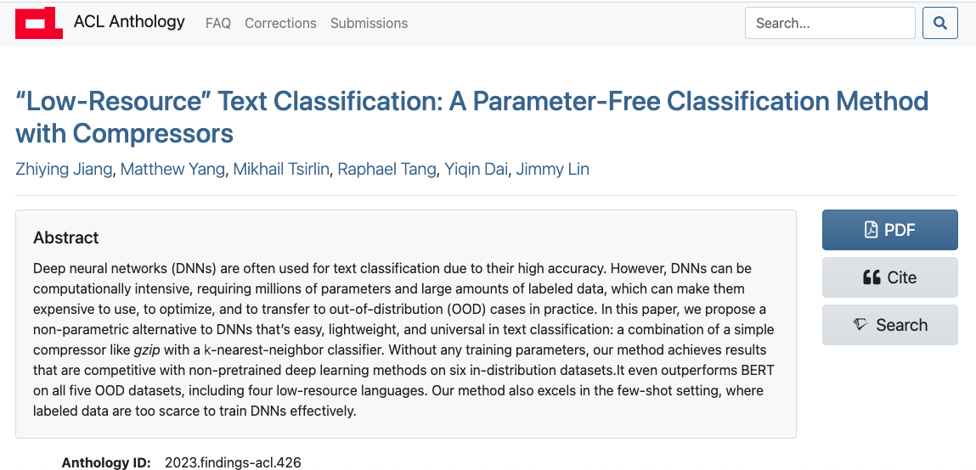
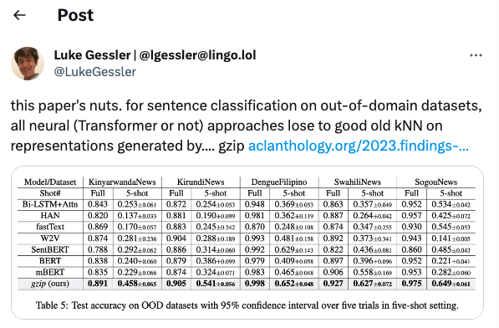
Don’t we need complex neural networks for all NLP tasks?!
You can get pretty far with simple methods! This paper uses a zip file representation with kNN to beat DNN in sentence classification. So complex may not be worth the effort.

Slide 15
A bit more complex polarity
Scoring
Identify a polarized word from a lexicon
Identify “context cluster” – 4 words previous & 2 words after
ID Neutral Words
ID Amplifiers “very”
ID de-amplifiers i.e. “hardly”
ID Negators i.e. “not”
Assign Values
Neutral Words = 0
Amplifiers = 0.8
De-amplifiers = -0.8
ID Negators = -1 *
Sum Values
Divide Sum by sqrt of word count – accounts for length of document “how dense the polarity is”
Let’s open ﻿A_polarity_math.R to see it in action.

Slide 16
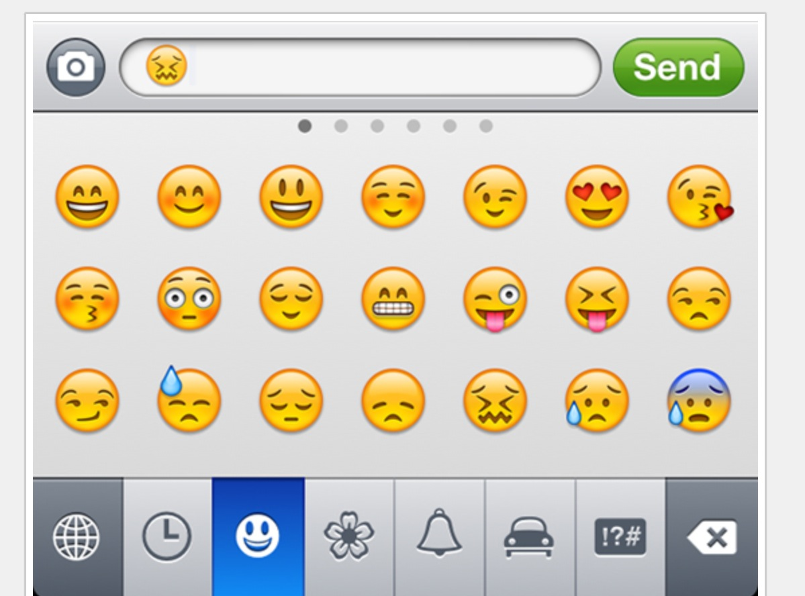
In reality sentiment is more complex.
Many Many Emoji

Slide 17
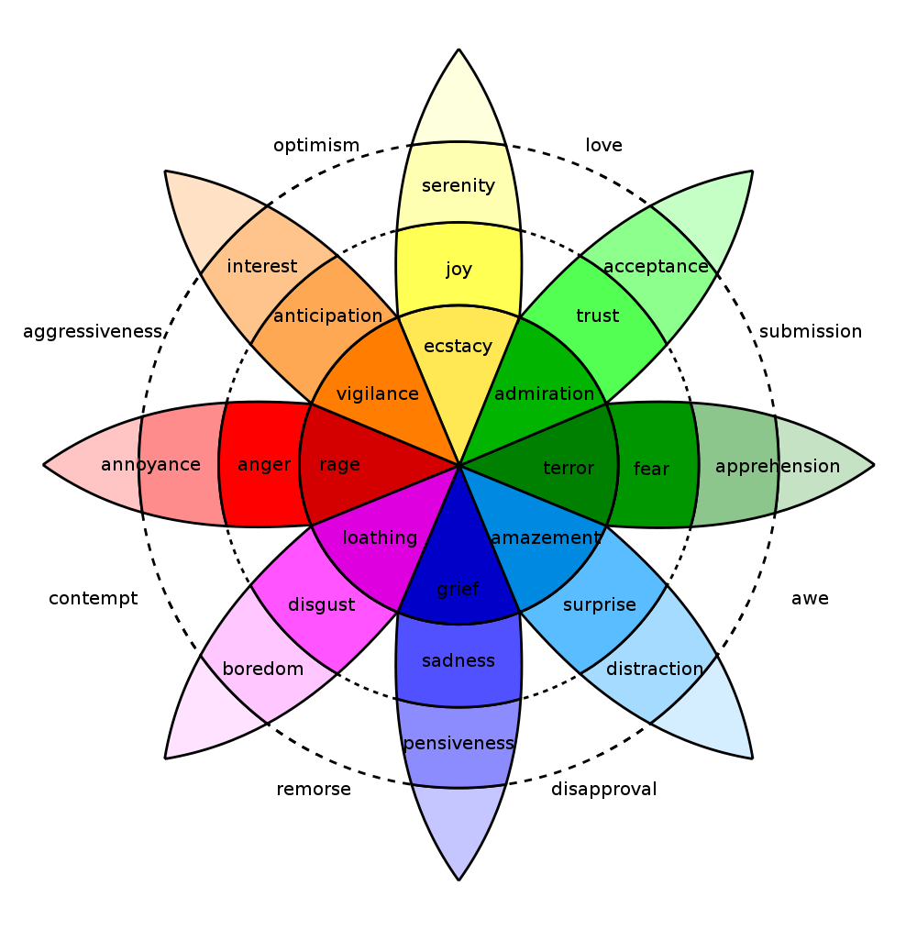
In reality sentiment is more complex.
Many Many Emoji

Slide 18
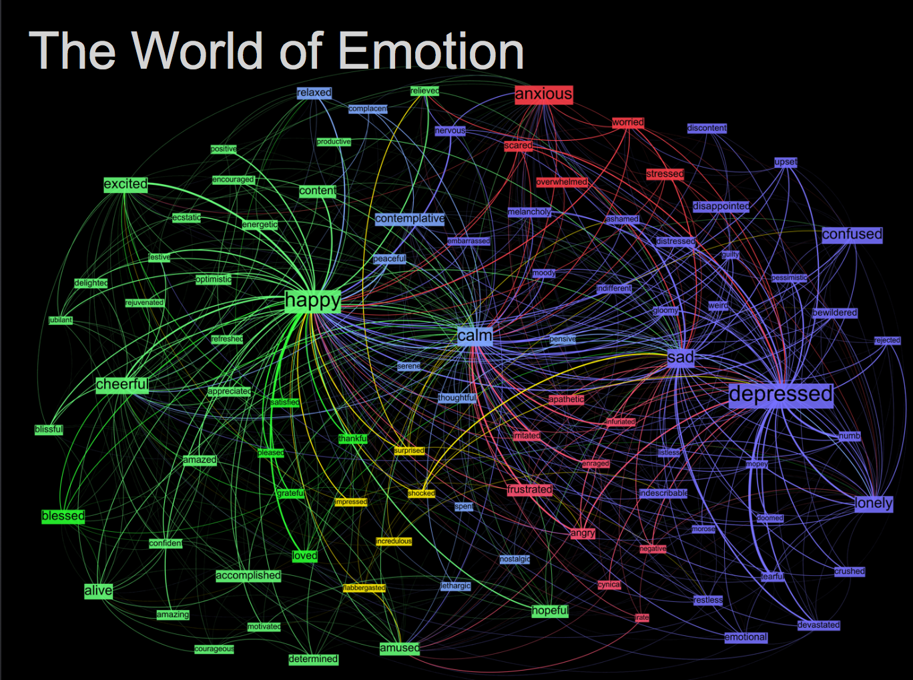
Kanjoya’s Experience Corpus

Slide 19
Tidy Data Formats are structured differently
Tidy Form (Triplet, Dense Data)
Document Term Matrix
Document | Term | count
Tweet1 | Term2 | 1
Twee1 | term3 | 1
Tweet2 | Term2 | 1
Tweet3 | Term… | 3
Tweet… | Term… | 1
Tweet… | Term_n | 1
Tweet_n | Term… | 1
 | Term1 | Term2 | Term3 | … | Term_n
Tweet1 | 0 | 1 | 1 | 0 | 0
Tweet2 | 0 | 1 | 0 | 0 | 0
Tweet3 | 0 | 0 | 0 | 3 | 0
… | 0 | 0 | 0 | 1 | 1
Tweet_n | 0 | 0 | 0 | 1 | 0
Sparse Data: Memory used to hold 0s
Dense Data: Efficient in Memory

Slide 20

The pipe operator…%>%

Slide 21
Tidy data uses %>% to forward objects
In the “tidyverse” code is structured so it is more easily read using the %>%. The data format is a tibble usually not a data frame.
mtcars
mtcars %>% group_by(cyl)
mtcars %>% group_by(cyl) %>% mutate(rank = min_rank(desc(mpg)))
This reads as “Using the mtcars object then group by the cyl vector then mutate a new variable called rank.

Slide 22
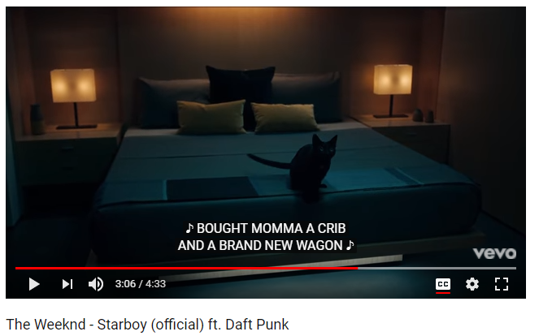
In this exercise we will examine song lyrics

Slide 23
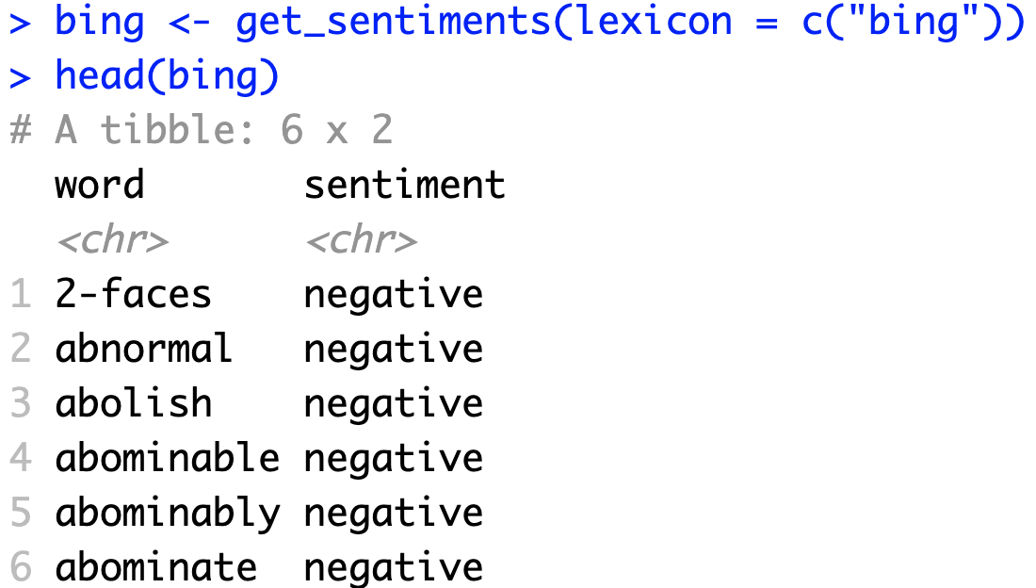
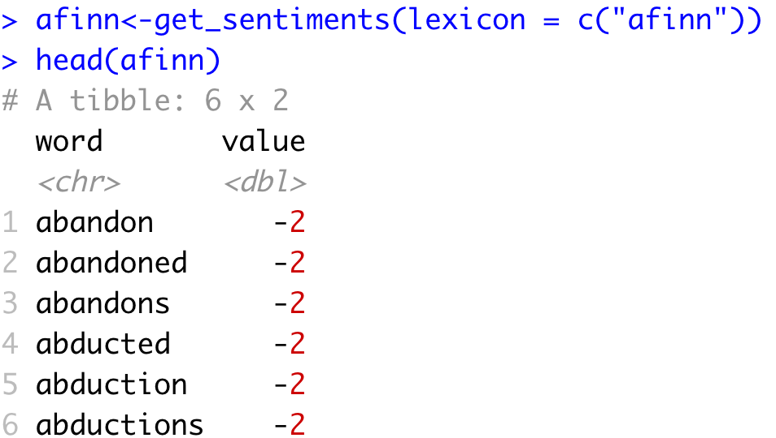
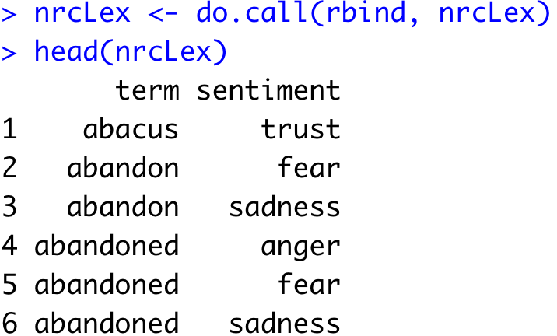
Sentiment the Tidy Way uses joins with existing lexicons
6782 Words
2477 Words
4463 Words

Slide 24
Tidy can seem complicated but not impossible.
The pipe operator
%>%
Forwards an object so the code is easy to understand & concise.
all.tidy <- all.tidy %>%
anti_join(stop_words)
Song text
Stop words
anti_join()
all.sentiment <- all.tidy %>%
inner_join(nrc.lexicon) %>%
count(tweet,sentiment) %>%
spread(tweet, n, fill = 0)
Sentiment
words
Song text
inner_join()

Slide 25
Starting with a DTM, its straightforward
# DTM
txtDTM <- DocumentTermMatrix(txtCorpus)
# Tidy
tidyCorp <- tidy(txtDTM)
# Get bing lexicon
bing <- get_sentiments(lexicon = c("bing"))
# Perform Inner Join
bingSent<-inner_join(tidyCorp,
bing, by=c('term'='word'))
DTM is from the “tm” library
Easy way to make it into a tibble.
Weeknd Lyrics
Bing Lexicon
* Due to some changes, the first time you use a sentiment lexicon, you will be asked to download. This is due to licensing.

Slide 26

Get in touch with our feelings…
Open B_sentimentAnalysis.R

Slide 27
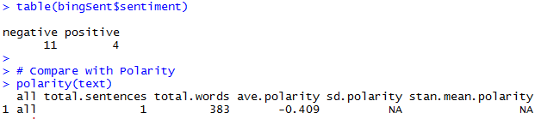
Similar polarity scores in both methods
Qdap’s polarity function calculates -0.409 for “Starboy” lyrics.

Slide 28
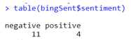
Similar polarity scores in both methods
Weeknd Lyrics
Bing Lexicon
Although less sophisticated & the scale is different, tidytext’s polarity is still negative

Slide 29
Let’s recreate Plutchik’s Wheel of Emotions
Back to the script!

